Slide 1

Industrobot4.0
Pick and Place robot for Material Handling
Team #14
Kalra, Nitesh (005528195)
Sanghai, Nikunj (505730005)
Wani, Shubham Kiran (105730007)

Slide 2
Agenda
Motivation and Task Definition
Literature Review
Object Detection and Sorting
Computed Feedforward Controller
PD controller with Gravity Compensation
Inverse Dynamics Control
Discussion and Conclusions
Q&A

Slide 3
Motivation and Task Definition
Nitesh Kalra
Motivation
Material handling/manipulation is a routine task in every industry, esp. e-commerce and manufacturing due to staffing issues.
The global pick-n-place robot market was valued at USD 148.1 million in 2020 and it is expected to reach USD 2870.13 million by 2026 [7].
Objectives of controller design (KPI)
Cycle Time < 10 sec ( sort frequency )
Torque i/p - 75% of Max Torques
Error (Joint position) < 5°
Velocity of Conveyor = 0.3 m/s
Task Definition
Phase 1 - Object Interception Trajectory
Phase 2 - Trajectory Tracking
Phase 3 - Object Placement Trajectory
Figure 1: Max Joint Torques
https://www.mordorintelligence.com/industry-reports/piece-picking-robots-market

Slide 4
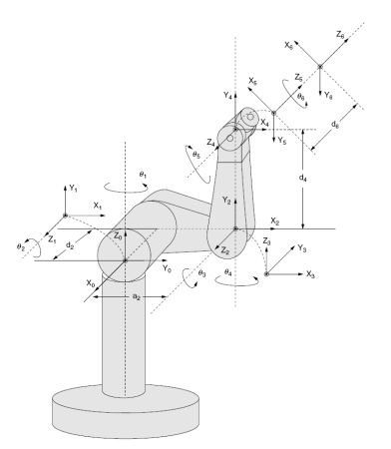
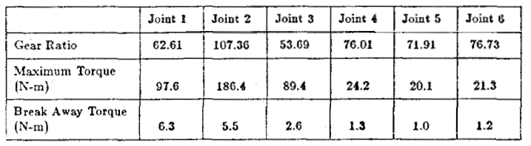
Literature Review
Nikunj Sanghai
Dynamics and Modelling Assumptions
Robot - Unimation Puma 560 [2]
Dynamics Equations - Inertia, Coriolis, Centrifugal, Gravity [3]
The first 3 axis provide position whereas the next 3 provide orientation. Moment of Inertia (M.o.I) is comparatively higher and hence control effort focuses on first 3. [3]
Uses Explicit Dynamics for simulation.
Modified D-H frame notation for a six degrees of freedom PUMA 560 robot manipulator[3]
Figure 2: Puma 560
Figure 3: Motor and Drive Parameters [3]
Notes:
as it is the most studied robot.

Slide 5
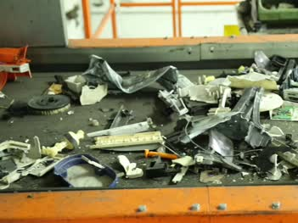

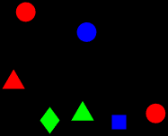
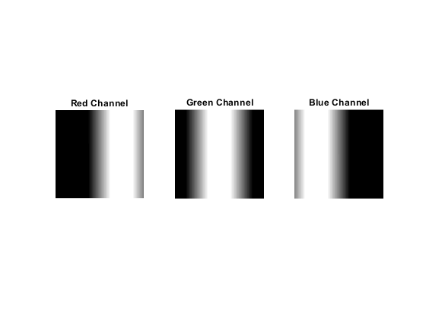

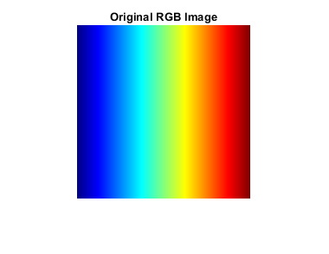

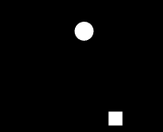
Object Detection and Sorting
Shubham Kiran Wani
Actual Conveyor Simulated Conveyor Parameters Single frame
Random Parameters:
Shape, Size, Colour
Set Parameters
Speed, Width, Time Step
Figure 4:
Flowchart
RGB Channel Separation MATLAB Image Processing Toolbox
imfindcircles
Circular Hough Transform
Centre, Radii, No. of Circles
Red
1
Green
bwlabel
Circularity R= 4*pi*A/P^2
Blob Perimeter, Area,
Location, Circularity
2
Blue
https://www.videvo.net/video/electric-waste-on-conveyor-belt-1/2200/
https://www.mathworks.com/help/images/display-separated-color-channels-of-rgb-image.html
Figure 5: RGB Layers
Notes:
https://www.videvo.net/video/electric-waste-on-conveyor-belt-1/2200/
https://www.mathworks.com/help/images/display-separated-color-channels-of-rgb-image.html

Slide 6
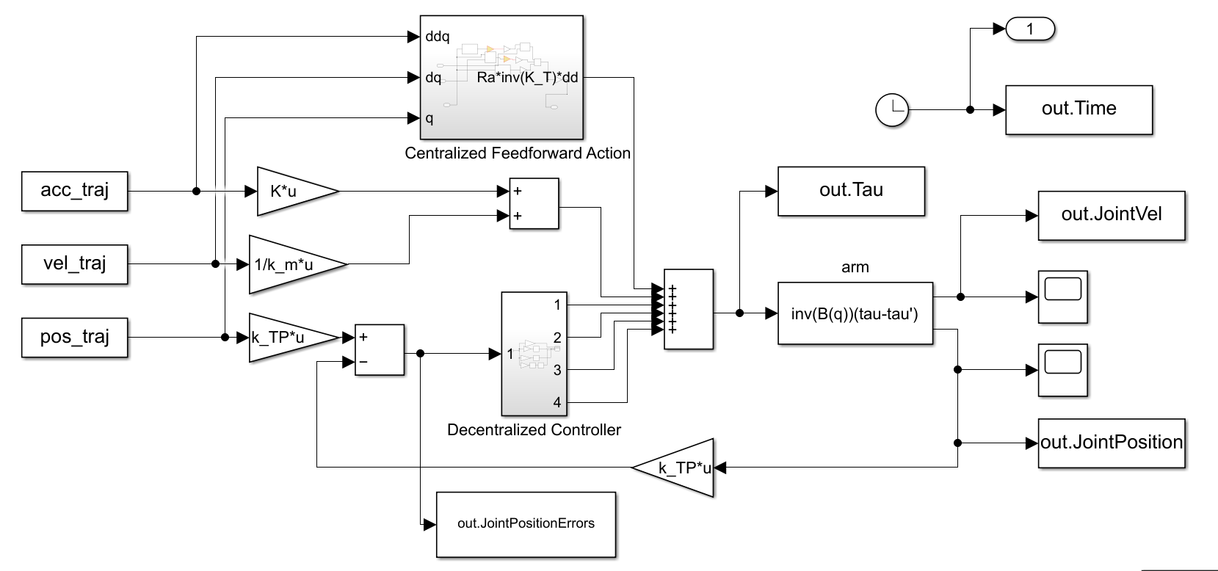
Computed Torque Controller
Nikunj Sanghai
Decentralized Feedforward action
Centralised Feedforward action
Figure 6: Computed Torque Control
Bruno Siciliano, et al. 2010. Robotics: Modelling,
Planning and Control. Springer Publishing

Slide 7
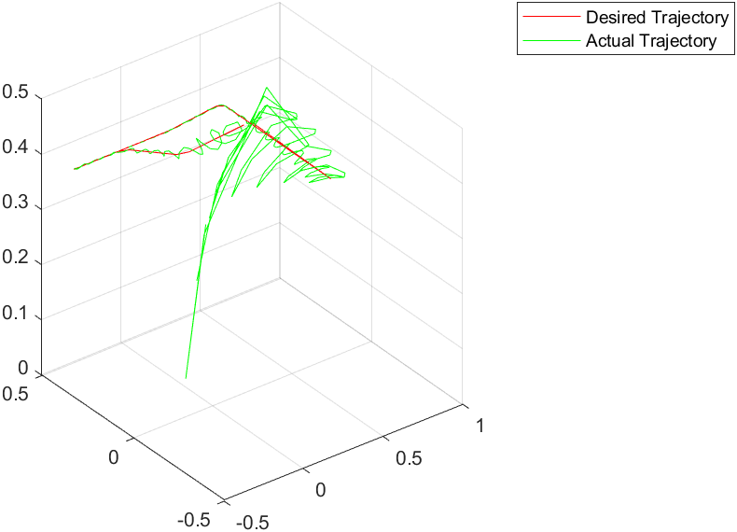
Computed Torque Controller
Nikunj Sanghai
Decentralized controller does not consider dynamic coupling of links.
The calculation of feedforward compensation is not able to account for couplings between the links thus accounting for very high error.
The speeds are quite high, and hence the controller failed.
Initial - K_{p}= 200*I_{6x6} ; K_{d}= 50*I_{6x6}
Final - K_{p}= 280*I_{6x6} ; K_{d}= 70*I_{6x6}
Figure 7: End Effector - Desired vs Actual Trajectory
Notes:
This controller is not at all suitable for this task, the whole point of this controller is to demonstrate problem faced if we use decentralized controller that does not consider dynamic coupling of links.
The coriolis, inertial matrix obviously have terms coupling terms present both are not perfectly diagonal. The calculation of feedforward compensation is not able to account for couplings between the links thus accounting for very high error.

Slide 8
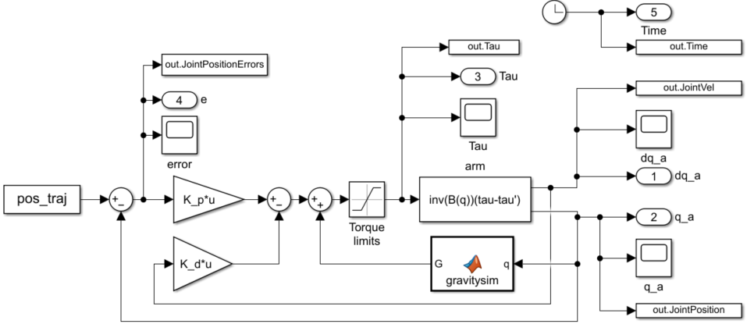
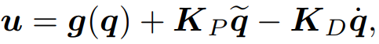
PD control with Gravity Compensation
Shubham Kiran Wani
Figure 8: PD Control with Gravity Comp.
Nonlinear gravity
compensation
Linear PD
action
Bruno Siciliano, et al. 2010. Robotics: Modelling,
Planning and Control. Springer Publishing

Slide 9
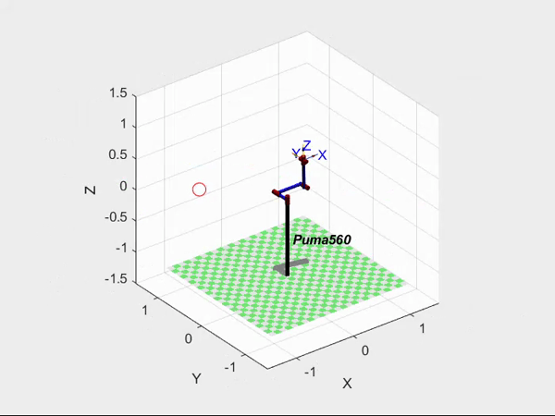
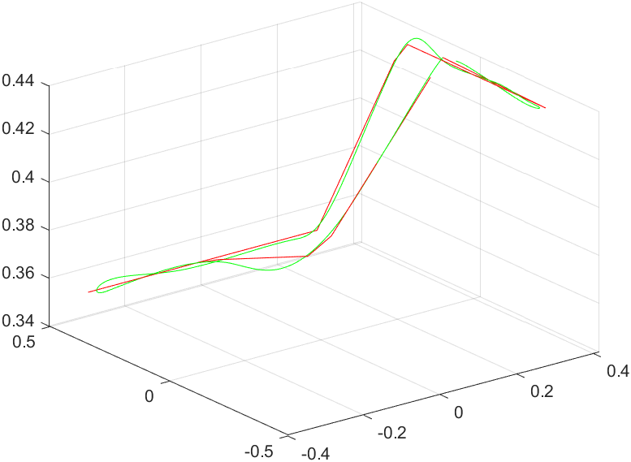

PD control with Gravity Compensation
Shubham Kiran Wani
Playback Speed = 0.3x
Video 1: Trajectory Tracking
Figure 9: End Effector - Desired vs Actual Trajectory

Slide 10
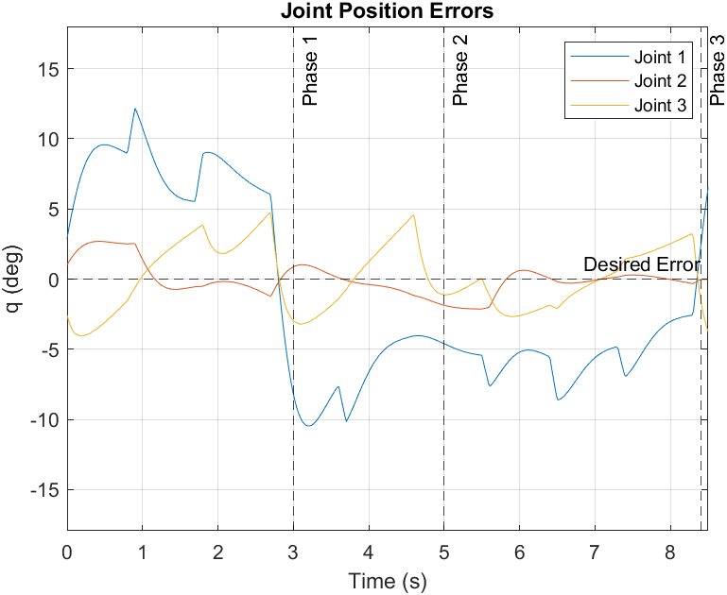
PD control with Gravity Compensation
Shubham Kiran Wani
Controller Design
Assumption: Speeds very low i.e. q̇ ~ 0 for global asymptotic stability for any Kp & Kd.
Simulation: q̇ ≠ 0 so errors expected
Result: Max error ~10 degree, moderate error but not suitable for pick and place.
Advantages:
Computationally inexpensive.
Great for low speeds.
Will always converge
Initial - K_{p}= 200*I_{6x6} ; K_{d}= 40*I_{6x6}
Final - K_{p}= 150*I_{6x6} ; K_{d}= 30*I_{6x6}
Figure 10: Joint Position Errors

Slide 11
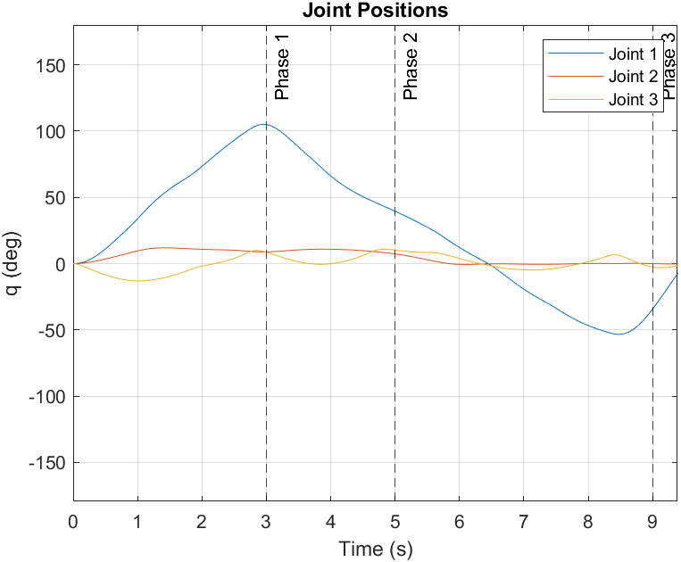
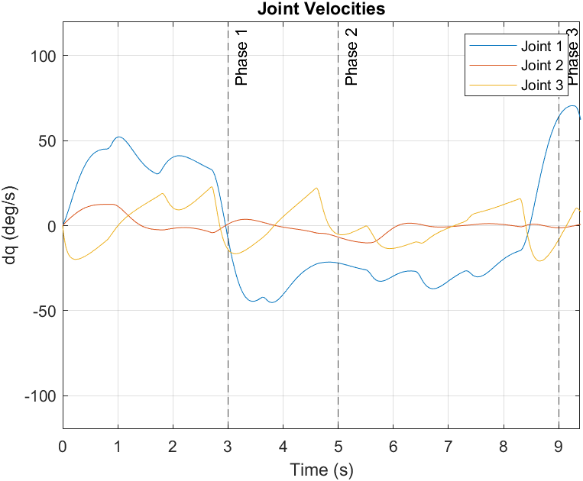
PD control with Gravity Compensation
Shubham Kiran Wani
Figure 11: Joint Positions
Figure 12: Joint Velocities

Slide 12
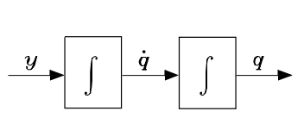
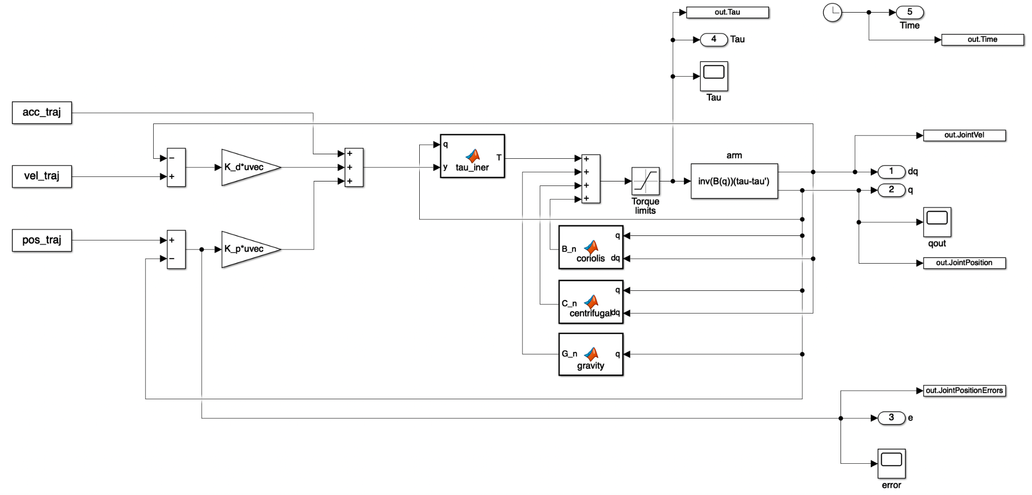
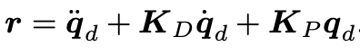
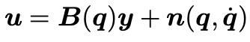
Inverse Dynamics Control
Nitesh Kalra
Stabilizing linear control
Nonlinear compensation and decoupling
Figure 13: Inverse Dynamics Control
Bruno Siciliano, et al. 2010. Robotics: Modelling,
Planning and Control. Springer Publishing
Notes:
Goal: Perform an exact linearization of system dynamics by using nonlinear state feedback.
Outer feedback loop is used to stabilize the overall system.
Inner feedback loop is used to obtain a linear and decoupled input/output relationship. The nonlinear control law is termed inverse dynamics control since it is based on the computation of manipulator inverse dynamics.
The system under control is linear and decoupled wrt the new input y.
In other words, the component y_i influences, with a double integrator relationship, only the joint variable q_i, independently of the motion of the other joints

Slide 13
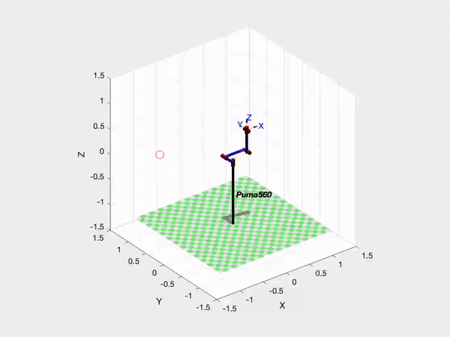
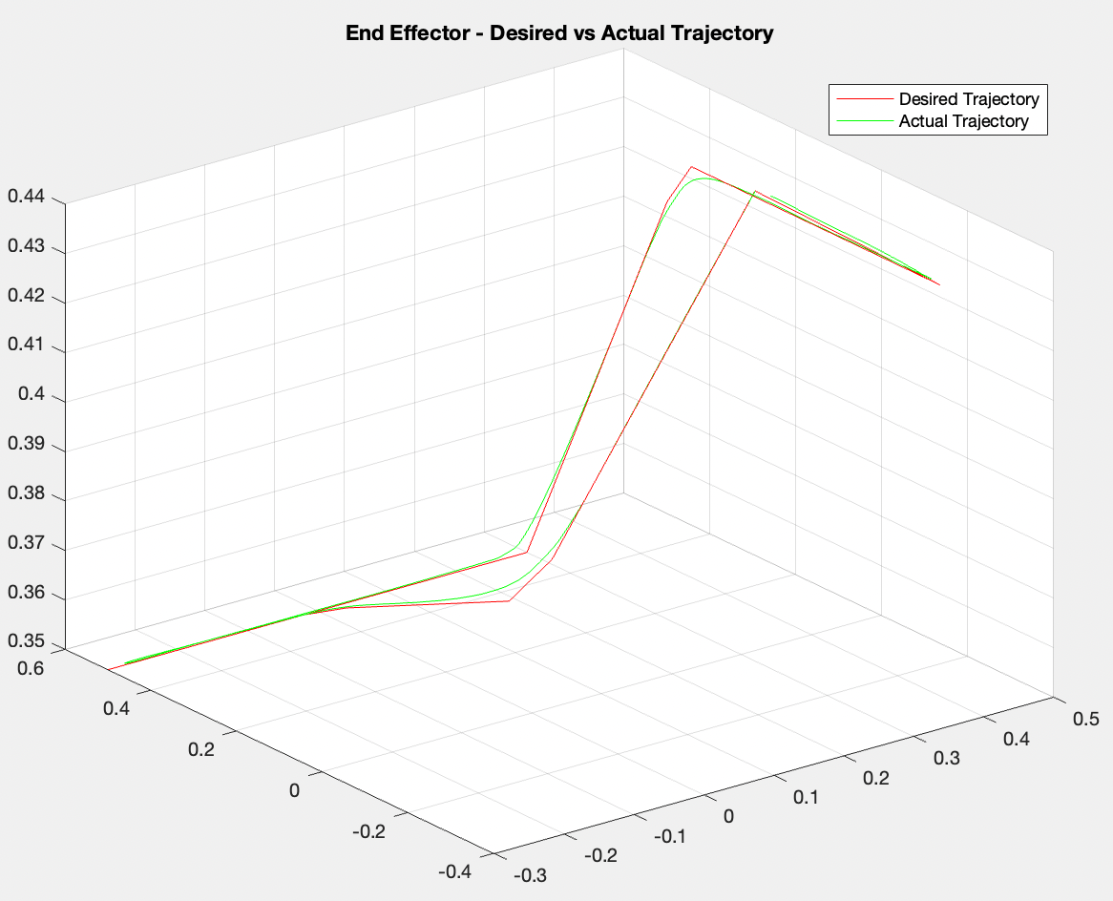
Inverse Dynamics Controller
Nitesh Kalra
Playback Speed = 0.5x
Video 2: Trajectory Tracking
Figure 14: End Effector - Desired vs Actual Trajectory

Slide 14
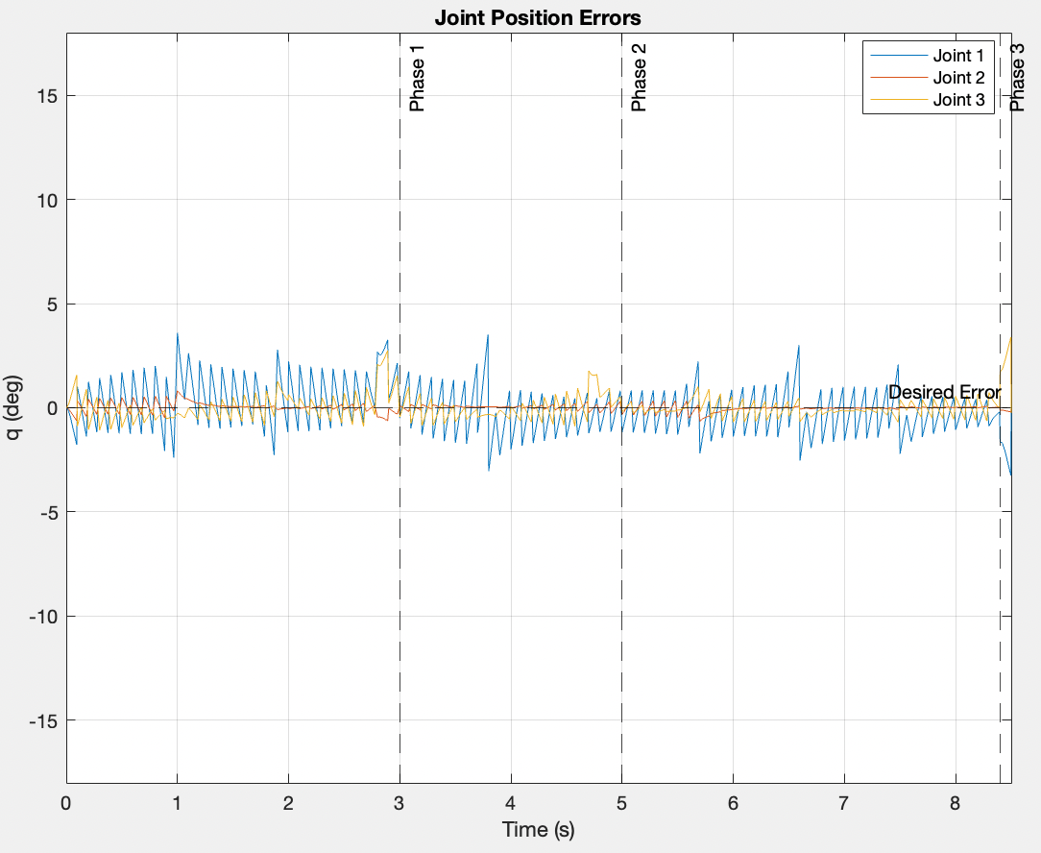
Inverse Dynamics Controller
Nitesh Kalra
Controller Design
Trial 1 - K_{p}= 150*I_{6x6} ; K_{d}= 25*I_{6x6}
Trial 2 - K_{p}= 1200*I_{6x6} ; K_{d}= 100*I_{6x6}
Final Design - K_{p}= 200*I_{6x6} ; K_{d}= 40*I_{6x6}
Result - Max error < 3.5° (Joint 1)
Challenges
Accuracy of parameters of the system dynamic model
Online computation
Figure 15: Joint Position Errors
Notes:
Challenges -
Implementation of inverse dynamics control laws indeed requires that parameters of the system dynamic model are accurately known and the complete equations of motion are computed in real time.
This is because this technique is based on the assumption of perfect cancellation of dynamic terms and control is now based on nonlinear feedback of the current system state, and thus it is not possible to precompute the terms offline.
Exact nonlinear compensation can be computationally demanding, which may necessitate-
Complex hardware architecture
Decreased sampling rates to allow for control law computation time

Slide 15
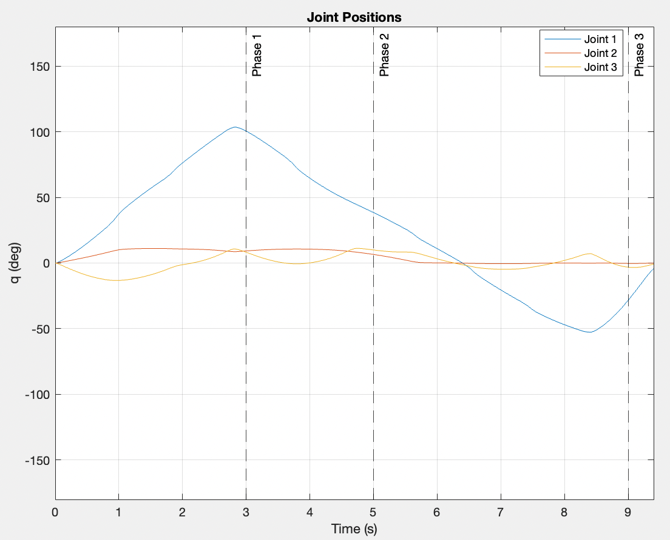
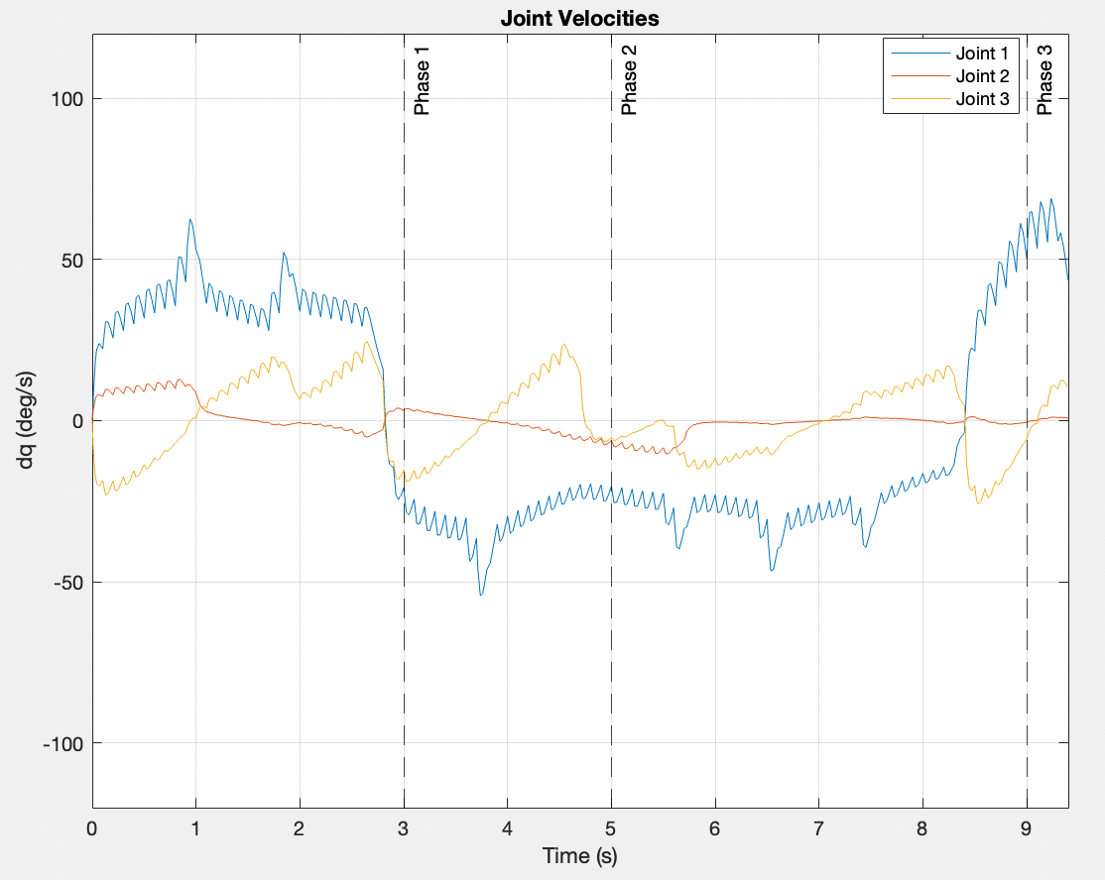
Inverse Dynamics Controller
Nitesh Kalra
Figure 16: Joint Positions
Figure 17: Joint Velocities

Slide 16
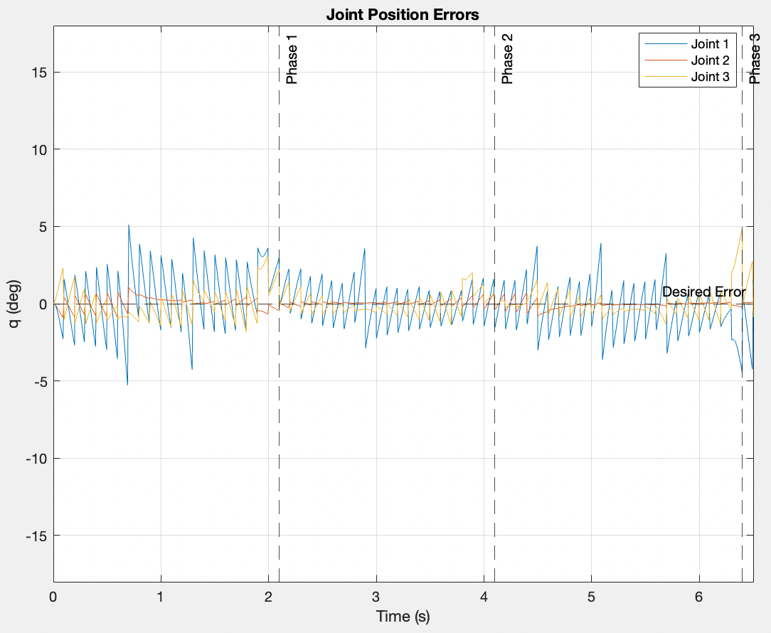
Discussion and Conclusion
Studied 3 controllers for high speed pick and place operation
Cycle time, t = 9.5 [sec]
CTFA = Max error
PDGF = Max error < 10° in Joint 1
IDC = Max error < 3.5° in Joint 1
Error analysis for task at higher speed
To further demonstrate the robustness of Inverse Dynamics Control for these applications, we ran the task with higher speeds
Cycle time, t = 7.1 [sec]
Max error ~5° in Joint 1
Figure 18: Joint Position Errors
Notes:
Reason: IDC performs an exact linearization of system dynamics by using nonlinear state feedback.
This is because this technique is based on the assumption of perfect cancellation of dynamic terms and control is now based on nonlinear feedback of the current system state

Slide 17
References
Bruno Siciliano, Lorenzo Sciavicco, Luigi Villani, and Giuseppe Oriolo. 2010. Robotics: Modelling, Planning and Control. Springer Publishing Company, Incorporated.
B. Armstrong, O. Khatib and J. Burdick, "The explicit dynamic model and inertial parameters of the PUMA 560 arm," Proceedings. 1986 IEEE International Conference on Robotics and Automation, 1986, pp. 510-518, doi: 10.1109/ROBOT.1986.1087644.
Farzin Piltan, S. Emamzadeh, Z. Hivand, F. Shahriyari & Mina Mirazaei. ” PUMA-560 Robot Manipulator Position Sliding Mode Control Methods Using MATLAB/SIMULINK and Their Integration into Graduate/Undergraduate Nonlinear Control, Robotics and MATLAB Courses” International Journal of Robotics and Automation, 3(3): 2012.
P.I. Corke, “Robotics, Vision & Control”, Springer 2017, ISBN 978-3-319-54413-7
MATLAB. (2019). 9.7.0.1190202 (R2020b). Natick, Massachusetts: The MathWorks Inc
https://manipulation.csail.mit.edu/pick.html
https://www.mordorintelligence.com/industry-reports/piece-picking-robots-market

